Slide 1


RLPM Update
OPO Awareness Session
D. Di Iorio April 11th ,2025
EXPORT MARKING: NO TECHNICAL DATA
PRATT & WHITNEY PROPRIETARY | © 2025 PRATT & WHITNEY

Slide 2



Export control classification
DATE OF MARKING (YYYY-MM-DD): | 2025-02-18 | BADGE (XX######): | PW51027
X
Check this box if the document contains no technical data.
OR
Summarize the export classification of all slides in this presentation as instructed below.
Classifications must always be provided for U.S. and Outside U.S. boxes. When the person completing the grid is physically located outside of the U.S., the local classifications must also be provided. | CLASSIFICATION
 | LOCATION | U.S. REGULATION
 |  | EAR | ITAR
 | U.S. | P-ECCN | P-USML
 | OUTSIDE U.S. | ECCN | USML
 |  | LOCAL REGULATION
 | CANADA | EIPA (ECL) | DPA (CG)
 |  |  | Document may be DPA controlled if EIPA value starts with “2” or US ITAR box contains any value other than “NSR”.
For instructions and examples on how to fill in this slide, click here
When you are located outside of Canada, modify the Local Regulation section accordingly
PROPRIETARY NOTICE
THIS DOCUMENT IS THE PROPERTY OF PRATT & WHITNEY CANADA CORP. (“P&WC”). YOU MAY NOT POSSESS, USE, COPY OR DISCLOSE THIS DOCUMENT OR ANY INFORMATION IN IT, FOR ANY PURPOSE, INCLUDING WITHOUT LIMITATION TO DESIGN, MANUFACTURE OR REPAIR PARTS OR OBTAIN TCCA, FAA OR OTHER APPROVAL TO DO SO, WITHOUT P&WC’S EXPRESS WRITTEN PERMISSION. NEITHER RECEIPT NOR POSSESSION OF THIS DOCUMENT ALONE, FROM ANY SOURCE, CONSTITUTES SUCH PERMISSION. POSSESSION, USE, COPYING OR DISCLOSURE BY ANYONE WITH GOVERNMENT OUT P&WC’S EXPRESS WRITTEN PERMISSION IS NOT AUTHORIZED AND MAY RESULT IN CRIMINAL OR CIVIL LIABILITY.
EXPORT CLASSIFICATION: [NO TECHNICAL DATA] DATE OF MARKING: [2025-02-18], BADGE #: [PW51027]
PRATT & WHITNEY CANADA PROPRIETARY FOR PLANNING PURPOSES ONLY
EXPORT MARKING: (TO CHANGE GO TO INSERT > HEADER & FOOTER)
PRATT & WHITNEY CANADA PROPRIETARY | © 2025 PRATT & WHITNEY CANADA CORP.

Slide 3
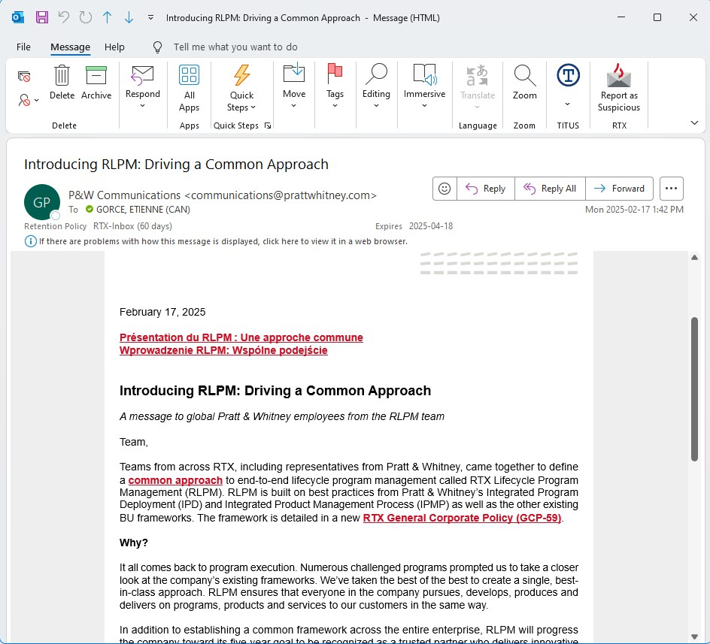
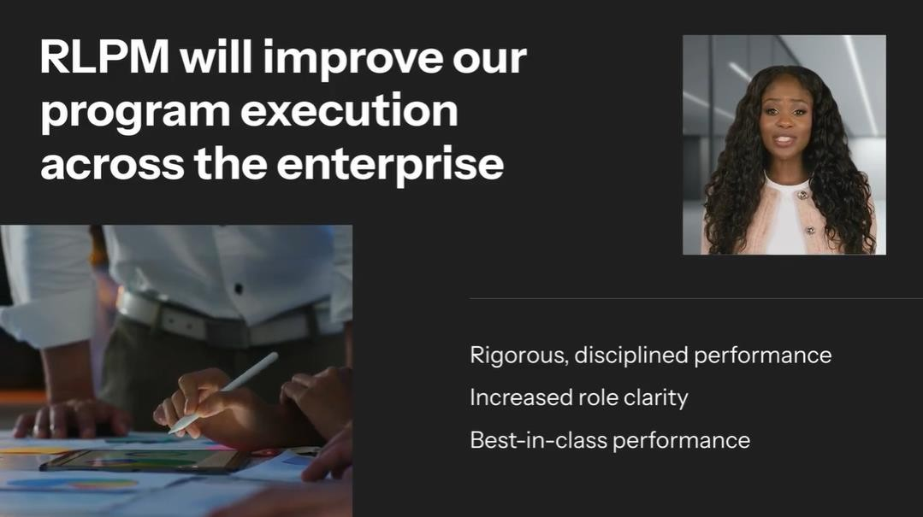
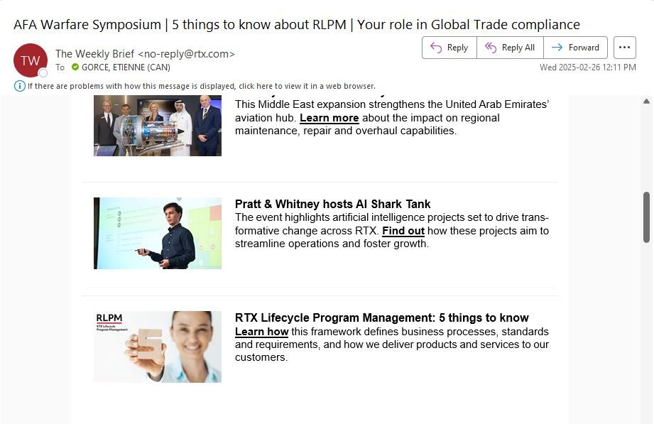
RLPM
General Email received on Feb-17
Video included in email
Email received on Feb-26
Feb-26: Nathalie’s staff
March 4: Laurent’s staff (Dominic)
March 6: Presentation to MDP
RLPM: RTX Life Program Management
EXPORT MARKING: NO TECHNICAL DATA

Slide 4
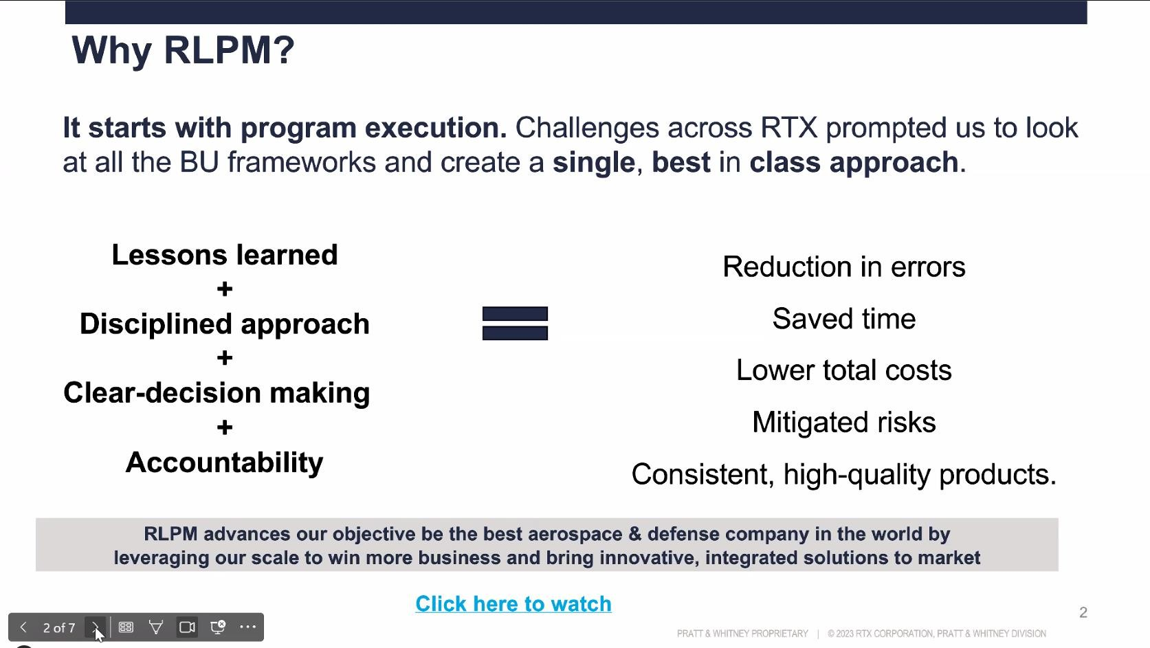
RLPM
RLPM: RTX Life Program Management
EXPORT MARKING: NO TECHNICAL DATA

Slide 5
RLPM P&WC Incorporation
BLUF
RLPM Implementation progressing to April 1 L1 document readiness
P&WC implementation; Compliance to RLPM through updates to MMP220 & MMP219
Coordinated with PW implementation
RLPM Framework provides opportunities to enhance IPMP reset governance (Plans, Archetype/ Tailoring)
Program transition will require L1 and key L2 document updates (post April 1 per RTX timeline)
EXPORT MARKING: (TO CHANGE GO TO INSERT > HEADER & FOOTER)
PRATT & WHITNEY CANADA PROPRIETARY | © 2025 PRATT & WHITNEY CANADA CORP.
5

Slide 6
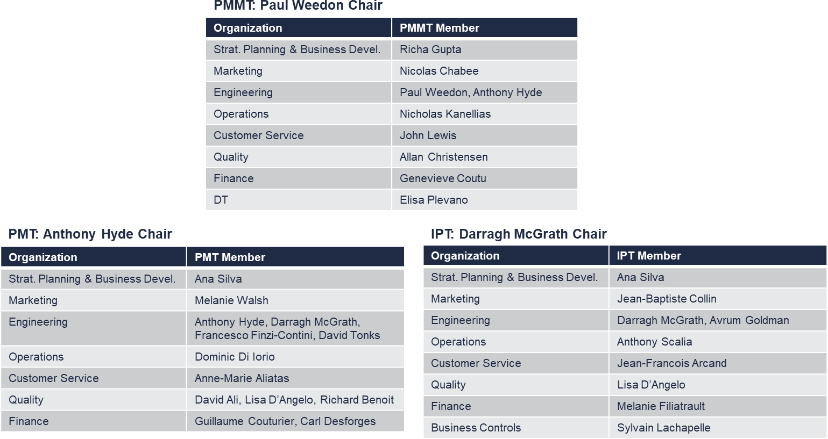
RLPM P&WC Implementation team
Implementation team
SLT engagement through PMMT steering
MMP220 & MMP219 Leads
Collaborative effort - enterprise alignment weekly at PMT & PMMT level (Scrum approach)
PMT weekly workshops to align on key updates
Single point of contact with PWA
effort to ensure L1 alignment
Enterprise Fellows/SME review March 19 prior MMP Ballot (April 1)
Collaborative efforts across the business

Slide 7
RLPM Schedule
Q3
Q4
Q1
Q2
Q3
P&W RLPM
Jul
Aug
Sept
Oct
Nov
Dec
Jan
Feb
Mar
Apr
May
Jun
Jul
Aug
Sept
BU Policy Reviews
Homeroom Recommendation
RLPM
Policies
Compliance to RLPM Policies
RLPM Policies Released
PW
Document Updates
Final LW Doc Updates
RLPM Redlines & Iterations
RLPM Doc
Peer Reviews
Council
Reviews
Ballot
90 Day Effectivity
LW Updates Ballot Submission
RLPM
Ballot Submission
RLPM Level 1 Docs Released
Functional Gap Analysis
Comms / Learning Plan
Level 2 document updates/creation Training & Implementation
Implementation
Change Mgmt Workshop
Archetypes
Workshop
Program transition at next Gate
New program adoption
Metrics Incorporation
Sprint 1 – Define metrics & calculation Sprint 2 – DT CORE event
Sprint 3 – DT Estimation
Metrics Automation
90-day effectivity after April 1 require to support program transition to new framework
EXPORT CLASSIFICATION: NO TECHNICAL DATA
PRATT & WHITNEY CANADA PROPRIETARY | © 2025 PRATT & WHITNEY

Slide 8

P&WC RLPM Compliance Strategy & Deployment
Change
Timeline
Phase 1
Phase 2 Phase 3
90 days
Jan 2025
01st April
July 2025
2026
RTX
WP 1.5
PWC L1
Nomenclature
PMT Deliverables
GCP-59
General Policy
PWC L2
MMP219
MMP219
No update expected
Plans usage
Passport to Gates
Archetypes
Tailoring
PWC L3
MMP220
MMP220
Forms & template update only
PW
Change Scope
FSW
Functional Standard work
Entry/Exit Criteria
~50-100 Knowledge docs impacted across PWC
Milestones
Other phase req
Identify Key L2 (CS-
OP, EOP,..) Changes
Release Key L2
docs
BU Leadership
L2 mapping & change management plan par BU
BU Leadership
Recommended Content
Plans ; Ownership & L2 doc mapping
Plans template issued & L2 released
L3 change management plan par BU
PWC
Programs
Passports
Gates (RLPM)
RLPM considered
Effective Program Transition
EXPORT MARKING: (TO CHANGE GO TO INSERT > HEADER & FOOTER)
PRATT & WHITNEY CANADA PROPRIETARY | © 2025 PRATT & WHITNEY CANADA CORP.

Slide 9
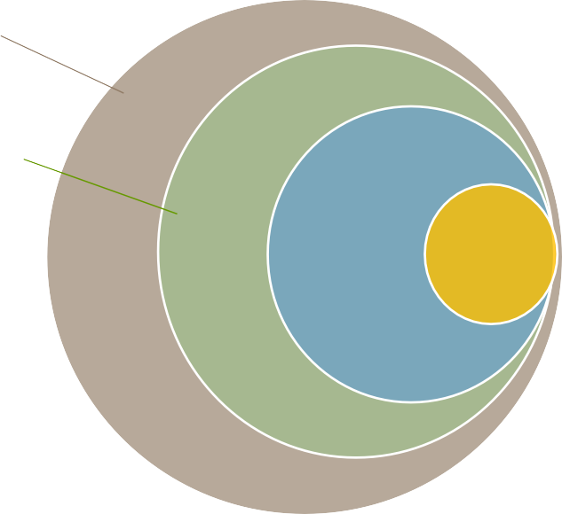

RLPM major changes
Key takeaway
Nomenclature Cheat sheet
Remains
P&WC IPMP Governance
Current | Future
Passport | RLPM Process
Passport Office | RLPM Office
Passport | Gate
Trigger Passport | Delta Gate
MMP 515 (AR) unchanged
Gated Process
Standardisation of templates and forms Waiver process
All Program
Archetypes
Changes
Plans; align & commit
Archetypes Tailoring
OVR formalised in MMP 444
MMP Archetype Tailoring
MRL & TRL Funded Maturation explicit plans
Program Plan Tailoring (Check-list)
Gate C – new Early P2
Waiver
Additional Gate – Discontinuity of Program Gate Trigger Criteria optimised
EXPORT MARKING: (TO CHANGE GO TO INSERT > HEADER & FOOTER)
PRATT & WHITNEY CANADA PROPRIETARY | © 2025 PRATT & WHITNEY CANADA CORP.

Slide 10
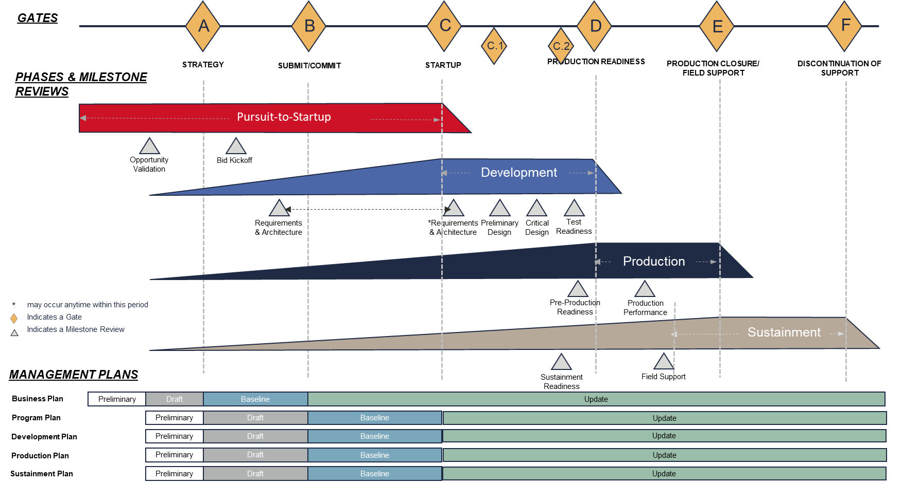
RLPM major changes
Nomenclature Was 0 1 2
P0
P1
P2
P3
P4
P4
P5
Now A B C
Framework
RTX - 6 formal Gates
MMP +2 sub-gates from C to D (PDR/CDR)
Gate C is effective new gate at Program launch
Tailoring concept
Plans
Templates in BU L2 docs
MMP Drives Plan accountability & PMMT Approval
Business Plan – Marketing/SFV Program Plan – PMMT Development Plan – Engineering Production Plan – OPS Sustainment Plan – Aftermarket
RTX Corporation (Corporate) - Proprietary
Technical Material not controlled under local export regulations. This document is not controlled under U.S. regulations but may contain Technical Material that is controlled by other jurisdictions.

Slide 11




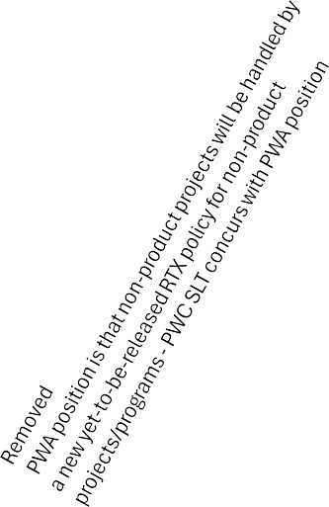

















RLPM- Defined Archetypes
Tier 3
↓
Complexity
Tier 1 → Program Type
Tier 2
↓ Total Program $
Demonstrator
Derivative
Support/ Product Upgrade
New Offering
Non-Product/Service?
Gumdrop - PW545C ($2M)
1
AT502XP - PT6A-140AG ($4M)
5
STO BTL Vane ressourcing ($1M)
STO TIMET Ti Mill Fire Shutdown ($1M) STO DCU Obsolescence ($3M)
<5
FReSH - PW210S ($5M)
2
AN-124/178 - APS2600N ($7M) EC135 - PW206B3 ($7M) Hurkus - PT6A-68T ($8M)
SMiF - PW307D ($11M)
Sky Courier - PT6A65SC ($13M) Latitude - PW306D1 ($14M) ATR - PW127N ($17M)
6
Heron - TSC ($8M) Pelican - XXXX ($9M) PT6C-67A Tiltrotor ($20M)
9
Minor Program Complexity
5-25
NEMO - HEP ($43M)
3
Sovereign - PW306D ($33M) Caravan - PT6A-140 ($35M) Falcon 8EX - PW307D ($40M) F2000 - PW308C+ ($40M)
7
25+
HEP ($205M)
Large T/fan Tech. Demo - LTTD ($TBD)
4
D'Artagnan - PT6E-66XT ($37M) Aspen - PW545D ($37M) Phenom 300 - PW535E ($47M) EC175 - PT6C-67E ($79M) AW169 - PW210A ($95M)
ATR - PW127XT ($112M) F6X - PW812D ($231M)
8
PW814/5 Front Hub Campaign ($44M) Boomerang - Vane machining ($70M)
Phoenix - PT6E-67XP ($83M) Phenom 100 - PW617F ($90M)
Mustang - PW615F ($103M) Falcon 7X - PW307A ($179M) S76D - PW210S ($180M)
Elevate - Tremblant & Jasper ($757M) G500/600/400 - PW800 ($1,454M)
10
PW Morocco ($71M)
Major Program Complexity
Optimus - Turbine Discs ($86M)
25+
Key
Propopsed Archetypes No archetype required
X Archetype ident
10 RLPM Archetypes Defined- Program Centric
RTX Corporation (Corporate) - Proprietary
Technical Material not controlled under local export regulations. This document is not controlled under U.S. regulations but may contain Technical Material that is controlled by other jurisdictions.

Slide 12
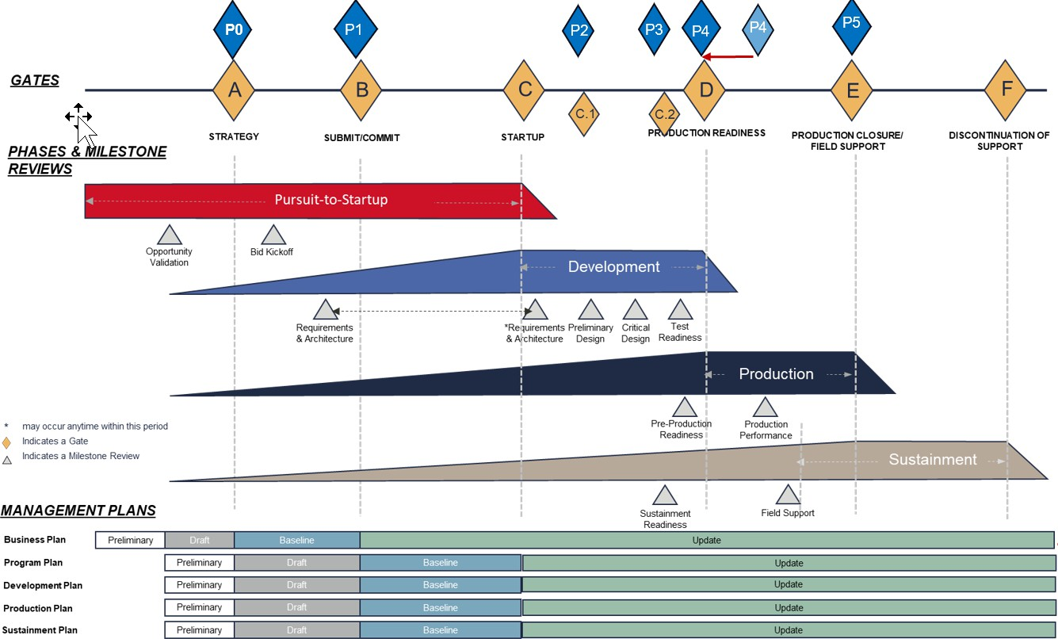
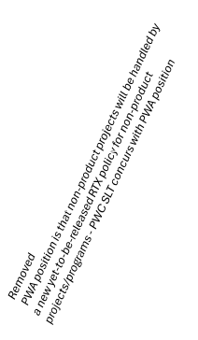
RLPM Agility via Tailoring
Tier 3 ↓ Complexity | Tier 1 → Program Type Tier 2 ↓ Total Program $ | Demonstrator |  | Derivative |  | Support/ Product Upgrade |  | New Offering |  | Non-Product/Service?
Minor Program Complexity | <5 | Gumdrop - PW545C ($2M) ₁ |  | AT502XP - PT6A-140AG ($4M) 5 |  | STO BTL Vane ressourcing ($1M) STO TIMET Ti Mill Fire Shutdown ($1M) STO DCU Obsolescence ($3M)
 | 5-25 | FReSH - PW210S ($5M) 2 |  | AN-124/178 - APS2600N ($7M) EC135 - PW206B3 ($7M) ⁶ Hurkus - PT6A-68T ($8M) SMiF - PW307D ($11M) Sky Courier - PT6A65SC ($13M) Latitude - PW306D1 ($14M) ATR - PW127N ($17M) |  | Heron - TSC ($8M) Pelican - XXXX ($9M) ⁹ PT6C-67A Tiltrotor ($20M)
 | 25+ | NEMO - HEP ($43M) 3 |  | Sovereign - PW306D ($33M) Caravan - PT6A-140 ($35M) ⁷ Falcon 8EX - PW307D ($40M) F2000 - PW308C+ ($40M)
Major Program Complexity | 25+ | HEP ($205M) Large T/fan Tech. Demo - LTTD ($TBD) ⁴ |  | D'Artagnan - PT6E-66XT ($37M) Aspen - PW545D ($37M) ⁸ Phenom 300 - PW535E ($47M) EC175 - PT6C-67E ($79M) AW169 - PW210A ($95M) ATR - PW127XT ($112M) F6X - PW812D ($231M) |  | PW814/5 Front Hub Campaign ($44M) Boomerang - Vane machining ($70M) |  | Phoenix - PT6E-67XP ($83M) Phenom 100 - PW617F ($90M) ¹⁰ Mustang - PW615F ($103M) Falcon 7X - PW307A ($179M) S76D - PW210S ($180M) Elevate - Tremblant & Jasper ($757M) G500/600/400 - PW800 ($1,454M) |  | PW Morocco ($71M) Optimus - Turbine Discs ($86M)
Key
 | Propopsed Archetypes No archetype required | X Archetype ident
10 RLPM Archetypes
5 RLPM Lifecycle BU Plans
RLPM Tailoring Capability -Intersection of Archetypes to 5 BU Plans
RTX Corporation (Corporate) - Proprietary
Technical Material not controlled under local export regulations. This document is not controlled under U.S. regulations but may contain Technical Material that is controlled by other jurisdictions.

Slide 13
RLPM OVERVIEW-PRODUCTION
Strategy Startup Production ^{Production} Discontinuation of Submit/Commit _{readiness} closure/field support _{support}
C1
C2
Phases &
PIR0
PIR1
PIR1.5
PIR2
PIR3
PIR4
PIR4.5
PIR5
milestones reviews
Production
OVR
Pre-Production Readiness
Production Performance
PURSUIT TO STARTUP
OVR Milestone - Funding, resource & schedule identified
Strategy - Prelim Production plan (White paper), Bid + DTUPC (D2C) targets Submit - Draft Production plan (KPI’s/PSSRB) /Funded MRL maturation plan Start-up - Approved baseline plan, draft MRL 6 maturation plan
DEVELOPMENT
Entry Criteria - Proposed MRL6 maturation plan by CDR (OPS PDRS)
Product cost model, Design to unit production cost targets or Design to cost targets
Baseline Sourcing Strategy/Facility assessment with requirements & plan
Exit Criteria - Achieve MRL8
Conversion of EBOM to MBOM ,production sources identified with approved rate plans Achieved production unit costs or cost reduction plan established & funded
PRODUCTION
Entry Criteria - Completion of Qualification testing, design for manufacturing/assembly, PPAP requirements
Meet producibility requirements (QN/LI) Product cost model aligned to design cost targets & yield Resource/Tooling/Equipment per plan (in place), Completion of customer support strategy Released Technical /Manufacturing data packages, Achievement of TRL/MRL 9
Exit Criteria - Performance AAR review to capture Initial production Lessons Learned
Completion of APQP/PPAP elements, product/process capability validation (Demonstrated rate readiness or approved funding) Documented Manufacturing risks & funding plan.
Update Sustainment plan, Preliminary production discontinuation strategy
13

Slide 14
Change Management & Communication plan
PMT/PMMT Steering committee reporting on enterprise implementation
MMP219 &
MMP220 Release
Effective Program Transition
Change Timeline
Phase 1
Phase 2
Phase 3
90 days
Jan 2025
01st April
July 2025
2026
P&W RLPM
Communication
Video
Program PMT
Briefings
&
BU Staff
meetings
P&WC Enterprise Communication (MMP changes)
Key L2 CS documents
CSOP 41
MMP530 – MMP515
TCCA/EASA
Briefings
Key L2 documents revision
Key Processes revision
EXPORT MARKING: (TO CHANGE GO TO INSERT > HEADER & FOOTER)
PRATT & WHITNEY CANADA PROPRIETARY | © 2025 PRATT & WHITNEY CANADA CORP.
14

Slide 15
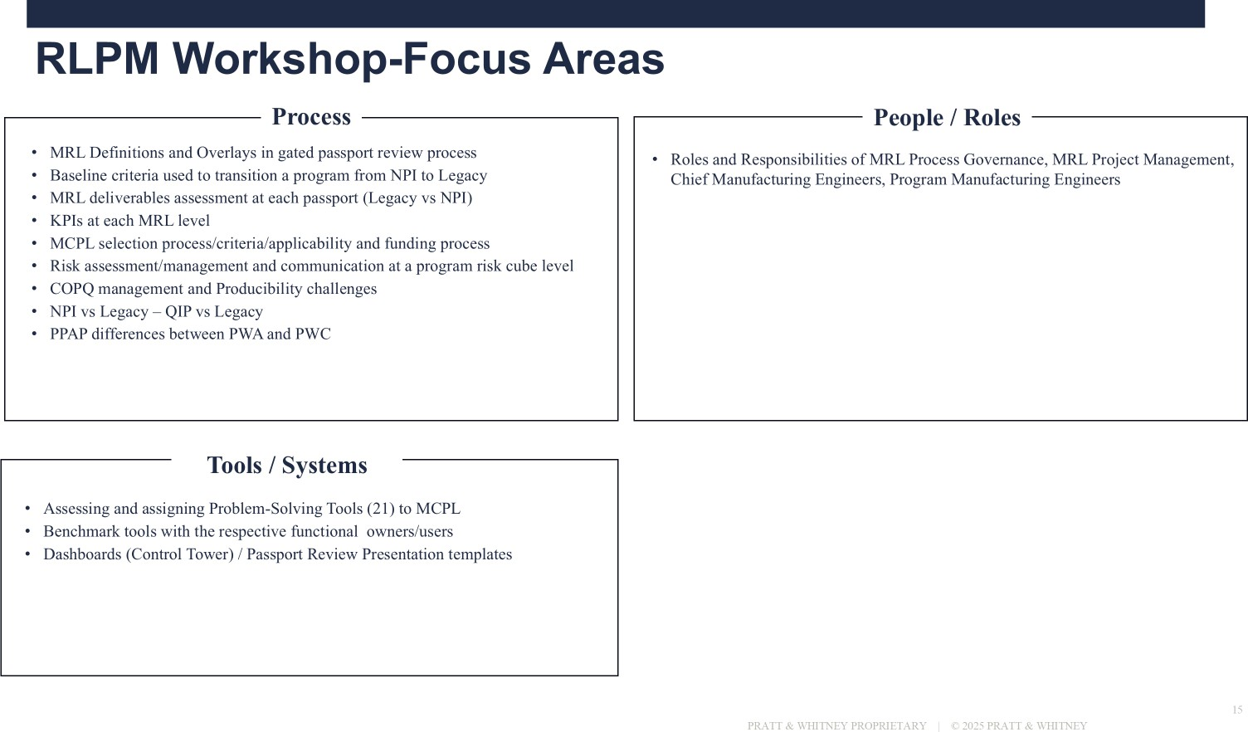
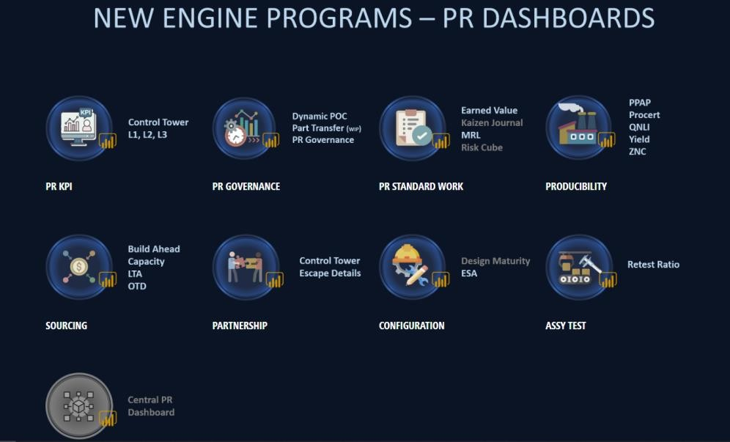
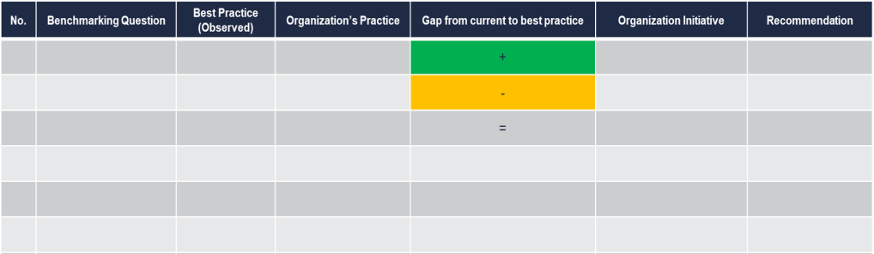
Next Steps-PW Workshop Mandate
3 Focus Areas for RLPM Production Phase
Process/Tools Gap Assessment & Alignment
Develop PW Best Practices on Production Plan Methodology (KPI’s/Boilerplates)
15
RTX Corporation (Corporate) - Proprietary
Technical Material not controlled under local export regulations. This document is not controlled under U.S. regulations but may contain Technical Material that is controlled by other jurisdictions.

Slide 16
EXPORT MARKING: (TO CHANGE GO TO INSERT > HEADER & FOOTER)
PRATT & WHITNEY CANADA PROPRIETARY | © 2025 PRATT & WHITNEY CANADA CORP.
16

